Slide 1
PSERS Board Meeting
March 8, 2018

Slide 2
Agenda
Hamilton Lane / PSERS Relationship 1
Operations and Technology 6
Asia Private Equity Market Overview 9
Appendix 27
Presenters
Mario Giannini
CEO
Corina English
Principal
Relationship Management
Sean Barber
Senior Associate Relationship Management

Slide 3
Hamilton Lane / PSERS Relationship

Slide 4
Private Markets Solutions
Hamilton Lane works with sophisticated institutional investors to access the full spectrum of private markets
Firm Spotlight¹ What We Offer
15 global offices
339 employees
Managed Solutions
t
d
D
e
b
B
u
e
y
s
o
s
u
e
t
r
t
s
i
Significant employee
ownership
D
R
Advised Solutions
e
e
n
a
i
l
n
a
E
z
s
z
t
Nasdaq-Listed: HLNE
e
a
M
t
Private Markets
e
Product Solutions
Fund-of-Funds
Secondary Funds
Co-Investment Funds
Strategic Opportunities Funds
$424B+ assets under management & supervision
V
I
e
n
nt
fr
u
a
r
s
e
t
r
$25.8B in primary commitments in 2017²
C
u
a
c
p
t
i
u
t
r
a
e
l
s
$243.9M invested alongside our clients
C
e
o
c
-
r
I
u
Technology Solutions
iLEVEL Solutions
Cobalt
n
o
v
s
e
e
s
R
t
l
m
a
e
r
n
u
t
t
a
S
e
n
y
N
c
r
o
d
a
Serving 27 public pension clients accounting for nearly 50% of total AUM¹
Distribution Management
¹ As of December 31, 2017.
² Please refer to endnotes in the Appendix.
Page 2 Proprietary and Confidential

Slide 5
A Partnership of the Utmost Importance
Hamilton Lane was founded in 1991 in Philadelphia as a Private Markets consultant to U.S. public pension plans
PA public schools are important to us³
62
Family members who teach/taught in PA public schools
91
Hamilton Lane employees who attended PA public schools
97
Children of employees who are enrolled/attended a PA public school
1,800+
Hours of service to PA public school systems by Hamilton Lane employees
Harrisburg
Bala Cynwyd
Maintaining our roots in diversity
Diversity & Inclusion Committee
40% women • 17% minority¹
We employ 245 people in the state of PA²
2017
2016
2015
2014
2013
2012
^{1,2}As of December 31, 2017
³ Data from Spring 2017 employee survey
Proprietary and Confidential
Page 3

Slide 6
An Extension of Your Staff
The Partnership
Relationship Management
Mario Giannini, CEO Michael Koenig, Managing Director
Corina English, Principal Sean Barber, Senior Associate
Rory Isdaner, Analyst
PSERS Staff
& Trustees
The Platform
Other Investment Teams
Fund Investment Team/Due
Monitoring & Reporting
Legal & Compliance
Research
Secondaries Co-Investment Real Estate
Diligence
Relationship Management Team is a partner and a conduit to Hamilton Lane’s resources
Collaborate together on defining goals and implementing an optimal portfolio
Page 4
Proprietary and Confidential

Slide 7
PSERS & Hamilton Lane Relationship
Summer 2017
iLEVEL and Cobalt training
Fall 2017
HL Investor Day HL Summit
NYC Market Overview
Fall 2017 / Winter 2018
Existing PM & HY Portfolios transitioned to iLEVEL
October 2018
Full Strategic Plan presented to Board for PM & HY Portfolios
June 2017 - March 2018
16 Recommendations to-date (3 new GP relationships)
Contract Signing
Client Training & Events
Portfolio Review
Transition
Pipeline Calls and Investment Updates
Investment Recommendations
Ongoing Education
Strategic Planning
September, 2017
PSERS/HL Contract Executed
August 2017
Full portfolio reviews with
Staff and Board members
Monthly
Pipeline calls for PM & HY Portfolios (9 calls to-date)
May 2018
Client training (potentially 4 PSERS Staff members attending)
December 2017
Strategic discussion on HY Portfolio
Ad-hoc
Ongoing deal calls on a
one-off basis
March 2018
Support Staff in Asset
Class Reviews
Proprietary and Confidential
Page 5

Slide 8
Operations and Technology

Slide 9
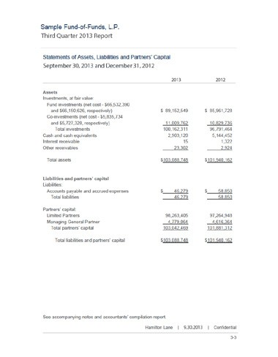
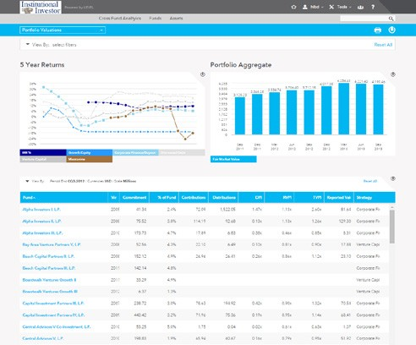
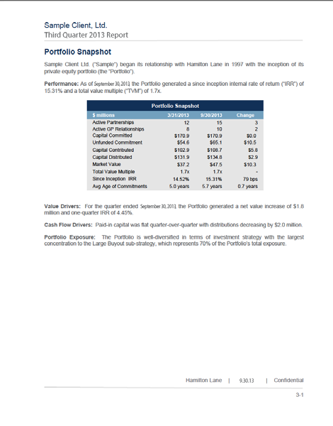
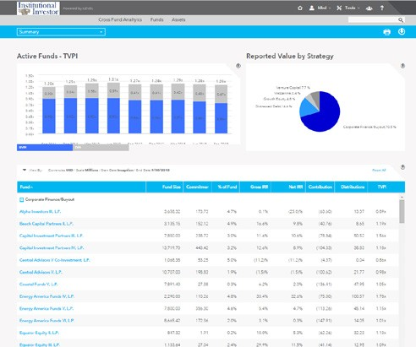
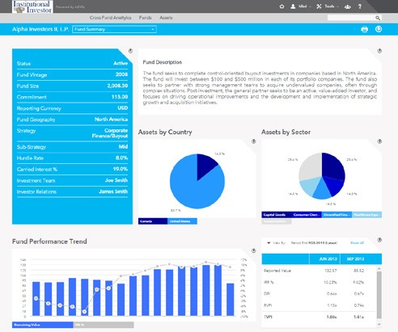
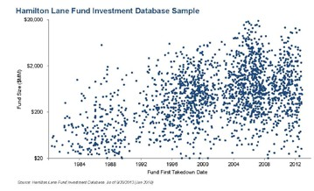
Operations Platform
Data Integrity and Controls
Customized Performance Reporting
Enhanced Technology
Comprehensive controls at every level of portfolio monitoring
Customized quarterly reports provide important details on client’s portfolio
Quantitative and qualitative performance
Portfolio diversification
Benchmarking
Underlying holdings review
Highly secure, web-based solutions providing 24/7 access to client portfolios: iLEVEL & Cobalt
Unique system automating the collection, storage, analysis and reporting of data to LPs
Unparalleled flexibility including future enhancements allowing for the exchange of data directly
between GPs to LPs for dynamic, detailed information sharing
Fully integrated with Excel for ease of use
Independent SOC-1 (SSAE16) audited control environment
More than 50 experienced professionals with finance and/or accounting background
Head of Reporting & Analytics Solutions
Data Manager
Vice President Client Services
Title
Subhead
Client
Portfolio Quarterly Report
Data Entry & Integrity
Portfolio Reporting & Analytics
Professionals
Professionals
As of September 30, 2017
Proprietary and Confidential
Page 7

Slide 10
Asia Private Equity Market Overview

Slide 11
Fundraising
Fundraising activity in Asia increased significantly by 32% from 2015 to 2016 to $109.3 billion
Australia, China and Japan saw meaningful increases
The region raised a total of $58.8 billion in H1 2017, which was a 49% increase over the $39.5 billion raised in the same period in 2016
Private Equity Fundraising by Country
$120
$109
$100
$82
$80
$76
USD in Billions
$60
$63
$60
$59
$45
$45
$51
$46
$40
$40
$25
$20
$0
2007 2008
2009
China
2010
India
2011
Japan
2012
Korea
2013 2014
Southeast Asia
2015
All Asia
2016
H1 2016
H1 2017
Australia / New Zealand
Source: AVCJ 2017 Regional Reports
Note: India date excludes real estate & global funds
Proprietary and Confidential
Page 11

Slide 12
Contribution Pacing
Rate of Contribution
Annual Contributions as a % of Unfunded
90%
80%
70%
60%
50%
40%
30%
20%
10%
0%
2005
2007
2009
2011
2013
2015
2017
Asia All PM
Source: Hamilton Lane Data via Cobalt (December 2017).
Asia’s rate of contribution has outpaced global rate of contribution in 2017
Page 12
Proprietary and Confidential

Slide 13
Investment Activity
PE capital invested in 2016 was flat relative to
2015
At $137.3 billion, investment levels were 44% higher than peak levels seen in 2007
China continues to represent the majority of PE investments in Asia, however, its proportion of overall Asian investments decreased from 51% in 2015 to 42% in 2016
Private Equity Investments by Country
$138 $137
$104
$89
$140
$120
$100
$80
$60
$40
$20
$0
USD in Billions
$95
$73
$76
$68
$70
$56
$50
$58
The recent increase Zealand investments
in Australian / New has been driven by
2007 2008 2009 2010 2011 2012 2013 2014 2015 2016
H1 H1 2016 2017
sizable infrastructure and utilities transactions
Australia / New Zealand
China
India
All Asia
Japan Korea Southeast Asia
Source: AVCJ 2017 Regional Reports
Buyout has remained the most widely utilized strategy by investment amount for the past two years
Other strategies including mezzanine, pre- IPO, PIPE and turnaround / restructuring have continued to become less prevalent
Asia VC investment activity has continued to decline since 2011
Private Equity Investments by Strategy
100%
 | 26% |  | 27% |  | 41% 3% |  | 36% |  | 44% 3% |  | 31% 2% |  | 21% |  | 14% |  | 14% |  | 9%
 |  |  |  |  |  |  |  |  |  |  |  |  |  |  |  |  |  |  | 10%
 |  |  |  |  |  |  |  |  |  |  |  |  |  |  | 7% |  | 12%
 |  |  |  |  |  |  |  |  |  |  |  |  | 6% |  | 42% |  |  |  | 31%
 | 6% |  | 9% |  |  |  |  |  |  |  |  |  | 31% |  |  |  | 30%
 | 22% |  |  |  |  |  |  |  |  |  | 27%
 |  |  | 30% |  |  |  | 3% 23%
 |  |  |  |  | 19% |  |  |  | 31%
 | 47% |  |  |  |  |  |  |  |  |  |  |  |  |  |  |  |  |  | 50%
 |  |  |  |  |  |  |  |  |  |  | 41% |  | 43% |  |  |  | 44%
 |  |  | 36% |  | 37% |  | 38% |  |  |  |  |  |  |  | 37%
 |  |  |  |  |  |  |  |  | 27%
80%
60%
40%
20%
0%
2007 2008 2009 2010 2011 2012
2013
2014
2015 2016
Buyout Growth Venture
Source: AVCJ 2017 Regional Reports
Others
Proprietary and Confidential
Page 13

Slide 14
M&A Activity
M&A Market Trend
While total M&A volume in Asia rose 7.1% in 2016, PE saw a slight decrease in its share of overall Asian M&A activity over the one-year period
Desire for internet-related assets drove investment activity during 2016
27.9%
25.9%
$800
$700
$600
$500
$400
$300
$200
$100
20.9%
23.3%
17.3 %
19.7%
19.4%
19.0%
14.9%
15.8%
$496
$531
$476
$372
$369
$385
$360
$336
$383
$313
2007 2008
Australia/New Zealand
2009 2010
2011 2012 2013 2014
2015
2016
China India
Japan Korea Southeast Asia
Source: AVCJ M&A Market Trends
PE Share in M&A Asia (line)
Private Equity Investments As % of GDP
Private Equity investments across Asia
3.5%
remain comparatively low relative to
3.0%
3.0%
Europe and North America
2.5%
2.0%
2.1%
2.1%
1.8%
1.9%
1.6%
1.5%
1.0%
0.8%
0.5%
0.4% _{0.3%} ^{0.5%} 0.4% 0.4%
Japan China India
0.5%
0.1%
0.0% 0.0%
0.0%
Europe N. America Vietnam Indonesia 2016
Australia
2015
Source: AVCJ, Dealogic, EIU Market Indicators, September 2016
Page 14
Proprietary and Confidential

Slide 15
Purchase Price Multiples by Geography
Purchase Prices
Median EV/EBITDA by Deal Year
10.0x
8.6x
9.0x
8.5x
8.7x
8.3x
8.9x
9.8x
10.4x
10.2x
8.1x
6.8x
7.9x
North America
5.0x
0.0x
# of Deals: | 164 | 260 | 303 | 193 | 147 | 237 | 237 | 265 | 227 | 289 | 241 | 167
10.0x
8.6x
10.6x
9.3x
9.1x
9.5x
10.5x
8.3x
8.7x
8.0x
8.6x
8.5x
7.0x
5.0x
Western Europe
0.0x
# of Deals: | 139 | 139 | 131 | 98 | 49 | 139 | 131 | 99 | 108 | 130 | 104 | 95
10.0x
9.6x
11.2x
9.2x
9.5x
11.0x
10.4x
6.8x
8.3x
7.8x
8.2x
7.8x
6.1x
5.0x
Asia
0.0x
# of Deals: | 7 | 8 | 8 | 10 | 6 | 11 | 9 | 8 | 8 | 10 | 11 | 10
2005 2006
Source: Hamilton Lane Data (December 2017)
2007
2008
2009
2010
2011
2012
2013
2014
2015
2016
Asian purchase price multiples have been similar to developed market purchase price multiples in recent years
Proprietary and Confidential Page 15

Slide 16
Leverage Multiples
Leverage Multiples at Acquistion
Net Debt / EBITDA
6.0x
5.5x
5.0x
4.5x
4.0x
3.5x
3.0x
2.5x
2.0x
1.5x
1.0x
0.5x
0.0x
2005
North America
2006 2007
Western Europe
2008
Asia
2009
2010
2011
2012
2013
2014
2015
2016
Source: Hamilton Lane Data (December 2017)
Leverage multiples in Asia are much lower than in developed markets
Page 16
Proprietary and Confidential

Slide 17
Distribution Pacing
Rate of Distribution
Annual Distributions as a % of NAV
70%
60%
50%
40%
30%
20%
10%
0%
2005
Asia All PM
2007
2009
2011
2013
2015
2017
Source: Hamilton Lane Data via Cobalt (December 2017).
Asia’s rate of distribution is lagging global rate of distribution
Proprietary and Confidential
Page 17

Slide 18
Exit Activity
Private Equity-Backed IPOs
The value of PE-backed IPOs has continued to decrease with a year-over- year drop of 29% in 2016 compared to 2015
$80
$70
$60
$50
$40
$30
$20
$10
$0
$64
$67
$67
USD in Billions
This is mainly attributed to a 32.0% decrease in Chinese private equity- backed IPOs
$39
$35
$40
$30
$28
$15
$17
2007
2008 2009
2010
2011
India
2012
Japan
2013
Korea
2014 2015
2016
Australia / New Zealand
China
Southeast Asia
Private Equity-Backed Trade Sale Exits
Conversely, PE-backed trade sales rose by 34.4% from $38.8 billion in 2015 to $52.2 billion in 2016
$60
$52
$50
$43
USD in Billions
$40
$39
$34
$32
$31
$30
$28
$27
$20
$17
$10
$0
2008 2009
2010
China
2011
India
2012
Japan
2013
2014
2015 2016
Australia / New Zealand
Korea
Southeast Asia
Page 18
Proprietary and Confidential

Slide 19
Asia Liquidity Ratios
Asia Focused Private Markets Liquidity Ratios
Annual Distributions / Annual Contributions
1.4x
Self-Funding Level
1.2x
1.0x
0.8x
0.6x
0.4x
0.2x
0.0x
2005 2006 2007 2008 2009 2010 2011 2012 2013 2014 2015 2016 2017
Source: Hamilton Lane Data via Cobalt (December 2017)
Asian private markets are on track to be cash flow negative for the second consecutive year as contributions have
outpaced distributions
Proprietary and Confidential
Page 19

Slide 20
Risk-Adjusted Returns
10 Year Asset Class Risk Adjusted Performance as of 6/30/2017
Asset Class | Annualized Total Return | Annualized Volatility | Sharpe Ratio
Asia Private Markets | 8.2% | 12.4% | 0.45
All Private Markets | 8.0% | 13.9% | 0.39
U.S. Equities | 7.3% | 16.9% | 0.27
High Yield Bonds | 7.2% | 11.7% | 0.39
High Grade Bonds | 6.6% | 6.7% | 0.59
REITs | 6.2% | 25.2% | 0.14
Public Infrastructure | 4.0% | 17.5% | 0.08
Hedge Funds | 3.0% | 7.5% | 0.04
Asia Equities | 2.6% | 18.9% | <0
Emerging Market Equities | 2.2% | 24.0% | <0
International Equities | 1.0% | 19.8% | <0
Private markets in Asia have performed on par with developed markets over the past 10 years
• Q3 2007 through Q2 2012:
Asia PM = 5.7%
All PM = 4.5%
• Q3 2012 through Q2 2017:
Asia PM = 10.8%
• All PM = 11.7%
Asian private markets performed better through the crisis and recovery, however, global private markets have outpaced the Asian markets in recent years
Indices used: Hamilton Lane All Private Equity with volatility de-smoothed; Russell 3000 Index; Credit Suisse High Yield Index; Barclays Aggregate Bond Index; FTSE/NAREIT Equity REIT Index; S&P Global Infrastructure Index; HFRI Composite Index; MSCI Emerging Markets Index; MSCI World Ex US Index; Hamilton Lane Asia Private Equity; MSCI Asia Pacific Index. Geometric mean returns in USD. Assumes risk free rate of 2.6%, representing the average yield of the ten-year treasury over the last ten years. (December 2017).
Page 20
Proprietary and Confidential

Slide 21
Asia Private Markets vs. PME
Asia Private Markets IRR vs. PME
By Vintage Year
20%
15%
10%
5%
0%
2004 2005
2006
2007 2008
2009-2010
2011
2012
2013
2014
Asia Private Markets IRR
MSCI World Investable Market Index PME
MSCI AC Asia Pacific Investable Market Index PME
Source: Hamilton Lane Data via Cobalt, MSCI (December 2017). Excludes real estate, fund of funds, and secondary fund of funds
Private markets in Asia have historically outperformed both regional and global equities
Proprietary and Confidential
Page 21

Slide 22
IRR Performance over 3, 5 & 10 Year-Horizon
Asia Focused Private Equity Fund Pooled IRR Performance
14.0%
12.1%
12.3%
12.4%
12.0%
11.7%
11.8%
11.5%
10.0%
9.7%
9.6%
9.2%
8.8% 8.7%
8.0%
7.3%
6.0%
4.0%
2.0%
0.0%
All PE All Asia
3 Year Pooled IRR
5 Year Pooled IRR
10 Year Pooled IRR
Europe-Western
North America
Source: Hamilton Lane Data via Cobalt (December 2017)
Asia PE has performed in line with or outperformed its developed market peers
Page 22
Proprietary and Confidential

Slide 23
DPI Performance Across Fund Stages
Asia Focused Private Equity Fund DPI
By Fund Stage
1.40x
1.20x
1.14x
1.19x
1.00x
1.06x
1.00x
0.82x
0.80x
0.75x
0.76x
0.60x
0.54x
0.40x
0.35x
0.39x
0.36x
0.32x
0.20x
0.00x
Value Creating (VY 2012 - 2014)
Europe-Western
Harvesting (VY 2009 - 2011)
Mature
(VY 2006 - 2008)
All PE All Asia
North America
Source: Hamilton Lane Data via Cobalt (December 2017)
The Asia region’s distributions have been catching up to its developed market peers
Proprietary and Confidential
Page 23

Slide 24
TVPI Performance Across Fund Stages
Asia Focused Private Equity Fund TVPI
By Fund Stage
1.55x
1.54x
1.50x
1.47x
1.45x
1.46x
1.45x
1.44x
1.42x
1.40x
1.35x
1.36x 1.36x
1.35x
1.32x
1.30x
1.31x
1.30x
1.25x
1.20x
1.15x
Value Creating (VY 2012 - 2014)
Harvesting (VY 2009 - 2011)
Mature
(VY 2006 - 2008)
All PE All Asia Europe-Western
Source: Hamilton Lane Data via Cobalt (December 2017)
North America
Net multiples of the Asia region have outperformed developed market peers in 2012 to 2014 vintage years
Page 24
Proprietary and Confidential

Slide 25
Regional Investment Themes
China
India & South Asia
Driven by the transition from investment/export led economy to a consumption led economy
Investment opportunities in “new economy” sectors, such as technology, consumer, healthcare, services, continue to be attractive
Buyout opportunities are increasing and General Partners are getting more sophisticated in operational value-add capabilities
As China becomes increasingly integrated into the global economy and emerges a major consumer market, cross- border deals are becoming another big theme
Large population and rising middle-class consumer drive the opportunities in consumption related sectors
Although still lagging behind China, the improved infrastructure (increased internet capabilities) provides a good foundation for technology investment
Less established local players and global/regional funds are active
Japan & Korea
Australia & New Zealand
Traditional leveraged buyout continues to be the dominant investment opportunity
Structural changes in these countries drive carve-out
transaction deal flow from large conglomerates/chaebols
Business succession is one of the focuses for mid-market buyout General Partners, driven by the aging population and increasing market competition
Traditional leverage buyout continues to be the dominant investment opportunity
Domestic consumption driven businesses are major investment targets but regional expansion in Asia is a common growth strategy post-investment
General Partners are shying away from commodities and natural resources investments, but education and agriculture are growing export sectors
Proprietary and Confidential
Page 25

Slide 26
Appendix

Slide 27
Endnotes
Page 2
² Annualized based on commitments through August 31, 2017. Capital invested includes all primary commitments for which Hamilton Lane retains a level of discretion and all advisory clients commitments for which Hamilton Lane performed due diligence and made an investment recommendation. This amount excludes secondary investments and co-investments.
Page 28
Proprietary and Confidential

Slide 28
Endnotes
Page 2
Hamilton Lane Discretionary Track Record^{1,6}
As of June 30, 2017
¹ The Discretionary Track Record includes all commingled funds-of-funds and separate accounts managed by Hamilton Lane for which Hamilton Lane retains a level of discretion for the investment decisions, as of June 30, 2017. The results herein include all secondary fund investments (except as noted below), as well as primary fund investments where a commingled fund-of-funds or multiple accounts participated in an investment. This presentation does not include co-investments or investments made on behalf of two accounts which Hamilton Lane no longer manages. As of June 30, 2017 this presentation represents commitments of $42.5 billion; in total Hamilton Lane had $52.3 billion in commitments for all discretionary accounts, of which $5.7 billion represents co- investments.
² Hamilton Lane IRR represents the pooled IRR for all Discretionary Track Record investments within the relevant vintage year for the period from inception to June 30, 2017. The returns are net of management fees, carried interest and expenses charged by the underlying fund managers, but do not include Hamilton Lane management fees, carried interest or expenses since it is not possible to allocate such items accurately in a composite measured at different points in time. The Hamilton Lane IRR would decrease with the inclusion of these fees, carried interest and expenses. See the hypothetical example below. Hamilton Lane has calculated and presented these returns on a pooled basis using daily cash flows. Performance results for the most recent vintage years are considered less meaningful due to the short measurement period, the incurrence of fees and expenses and the absence of significant distributions.
³ The Hamilton Lane Realized IRR represents the pooled IRR for those Discretionary Track Record investments that Hamilton Lane considers realized for purposes of its Discretionary Track Record, which are investments where the underlying investment fund has been fully liquidated, has generated a DPI greater than or equal to 1.0 or has an RVPI less than or equal to 0.2 and is older than 6 years. DPI represents total distributions divided by total invested capital. RVPI represents the remaining market value divided by total invested capital. These realized investments represent $11.2 billion of the $42.5 billion of total commitments included in the overall
Composite Performance
 | 5-Year | 7-Year | 10-Year
Hamilton Lane Realized IRR³ | 13.95% | 14.80% | 10.63%
Spread vs. S&P 500 PME (bps)⁵ | (269) bps | (221) bps | 212 bps
Spread vs. MSCI World PME (bps)⁵ | 47 bps | 228 bps | 522 bps
Hamilton Lane Total IRR⁴ | 13.39% | 13.51% | 10.94%
Spread vs. S&P 500 PME (bps)⁵ | (122) bps | (170) bps | 57 bps
Spread vs. MSCI World PME (bps)⁵ | 209 bps | 245 bps | 382 bps
Discretionary Track Record. The Hamilton Lane Realized IRR is measured for the 5-, 7- and 10-year periods ending June 30, 2017. These horizon returns are calculated on a point-to-point basis over the specified time periods. The contributions, distributions and remaining asset values at the beginning and ending dates of the horizon periods are used in calculating these returns. The returns are net of management fees, carried interest and expenses charged by the underlying fund managers, but do not include Hamilton Lane management fees, carried interest or expenses since it is not possible to allocate such items accurately in a composite measured at different points in time. The Hamilton Lane Realized IRR would decrease with the inclusion of these fees, carried interest and expenses. See the hypothetical example below. Hamilton Lane has calculated and presented these returns on a pooled basis using daily cash flows, where vintage years with larger amounts committed to investment have a proportionately larger impact on returns.
⁴ The Hamilton Lane Total IRR represents the pooled IRR for all Discretionary Track Record investments and is measured for the 5-, 7- and 10-year periods ending June 30, 2017. These horizon returns are calculated on a point-to-point basis over the specified time periods. The contributions, distributions and remaining asset values at the beginning and ending dates of the horizon periods are used in calculating these returns. These returns are net of management fees, carried interest and expenses charged by the underlying fund managers, but do not include Hamilton Lane management fees, carried interest or expenses since it is not possible to allocate such items accurately in a composite measured at different points in time. The Hamilton Lane Total IRR would decrease with the inclusion of these fees, carried interest and expenses. See the hypothetical example below. Hamilton Lane has calculated and presented these returns on a pooled basis using daily cash flows, where vintage years with larger amounts committed to investment have a proportionately larger impact on returns.
⁵ The indices presented for comparison are the S&P 500 and the MSCI World, calculated on a Public Market Equivalent (PME) basis. The PME calculation methodology assumes that capital is being invested in, or withdrawn from, the index on the days the capital was called and distributed from the underlying fund managers. Contributions were scaled by a factor such that the ending portfolio balance would be equal to the private equity net asset value. The scaling factor is found by taking the sum of all shares sold (SS), the sum of all shares purchased (SP) and calculating the number of shares the ending value is worth (SEV). Dividing SEV + SS by SP solves for the PME scaling factor. The scaling of contributions prevents shorting of the public market equivalent portfolio in order to match the performance of an outperforming private equity portfolio. Realized and unrealized amounts were not scaled by this factor. The S&P 500 Total Return Index is a capitalization weighted index that measures the performance of 500 U.S. large cap stocks. The MSCI World Index is a free float-adjusted market capitalization weighted index that is designed to measure the equity market performance of developed markets. The indices are presented merely to show general trends in the markets for the relevant periods shown. The comparison between Hamilton Lane performance and the index is not intended to imply that a fund’s or separate account’s portfolio is benchmarked to the index either in composition or level of risk. The index is unmanaged, has no expenses and reflects the reinvestment of dividends and distributions. The spreads are provided for comparative purposes only. A variety of factors may cause an index to be an inaccurate benchmark for any particular fund or separate account and the indices do not necessarily reflect the actual investment strategy of a fund or separate account.
⁶ The Hamilton Lane IRR for the 2017 Vintage Year, calculated on a non-annualized basis in a manner consistent with the CFA Institute’s standards for private equity performance reporting, as well as on a pooled basis using daily cash
flows, is 90.74%. Hamilton Lane does not consider this performance metric meaningful due to the very short measurement period.
⁷ At the time that this track record was generated, approximately 98% of June 30, 2017 fund reported market valuations have been received from General Partners. For all other Funds represented in this track record, Hamilton Lane uses the “Adjusted Market Value” methodology which reflects the most recent reported market value from the General Partner adjusted for interim net cash flows through June 30, 2017. This performance is subject to change as additional June 30, 2017 reported market values are received from the General Partners. A fund’s market value contains unrealized investments. Valuations of unrealized investments are based on valuations by the underlying managers. The actual realized returns on unrealized investments will depend on factors other than the original cost, such as the value of the assets and market conditions at the time of disposition, any related transaction costs, and the timing and manner of sale, all of which may differ from the assumptions on which the valuations contained herein are based. Accordingly, the actual realized returns on these unrealized investments may differ materially from the assumed returns indicated herein.
The following hypothetical illustrates the effect of fees on earned returns for both separate accounts and fund-of-funds investment vehicles. The example is solely for illustration purposes and is not intended as a guarantee or prediction of actual returns that would be earned by similar investment vehicles having comparable features. The hypothetical assumes a separate account or fund-of-funds consisting of $100 million in commitments with a fee structure of 1.0% on committed capital during the first four years of the term of the investment and then declining by 10% per year thereafter for the 12-year life of the account or fund. The commitments were made during the first three years in relatively equal increments, and the assumption of returns was based on cash flow assumptions derived from a historical database of actual private equity cash flows. We modeled the impact of fees on four different return streams over a 12-year time period. Under these models, the effect of the fees reduced returns by approximately 2%. This does not include performance fees since the performance of the account or fund would determine the effect such fees would have on returns. Expenses also vary based on the particular investment vehicle and, therefore, were not included in this hypothetical. Both performance fees and expenses would further decrease the return.
Past performance of the investments presented herein is not indicative of future results and should not be used as the basis for an investment decision. The information included has not been reviewed or audited by independent public accountants. Certain information included herein has been obtained from sources that Hamilton Lane believes to be reliable but the accuracy of such information cannot be guaranteed.
Proprietary and Confidential
Page 29

Slide 29
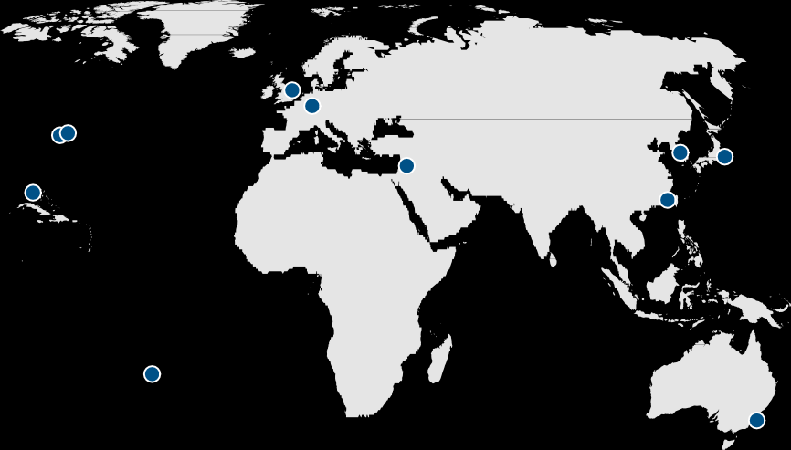
Contact Information
Philadelphia
One Presidential Blvd., 4th Floor Bala Cynwyd, PA 19004
USA
+1 610 934 2222
Tokyo
17F, Imperial Hotel Tower
1-1-1, Uchisaiwai-cho, Chiyoda-ku
Tokyo 100-0011 Japan
+81 (0) 3 3580 4000
Sydney
Level 36, Governor Phillip Tower, 1 Farrer Place,
Sydney, NSW 2000 Australia
+61 8823 3740
London
8-10 Great George Street London SW1P 3AE United Kingdom
+44 (0) 207 340 0100
Miami
999 Brickell Avenue
Suite 720
Miami, Florida 33131 USA
+1 954 745 2780
Munich
Leopoldstrasse 8-10
80802 Munich Germany
+49 89 954537901
Tel Aviv
14 Shenkar Street Nolton House
Herzliya Pituach, 46733
P.O. Box 12279 Israel
+972 9 958 6670
Portland
15350 SW Sequoia Pkwy Suite 260
Portland, OR 97224 USA
+1 503 624 9910
Hong Kong
Room 1001-3, 10th Floor St. George’s Building
2 Ice House Street Central Hong Kong, China
+852 3987 7191
San Francisco
201 California Street 5th Floor - Suite 550
San Francisco, CA 94111 USA
+1 415 365 1056
Rio de Janeiro
Av. Niemeyer 2, Sala 102 Leblon Rio de Janeiro Brasil 22450-220
+55 21 3520 8903
New York
610 Fifth Avenue, Suite 401 New York, NY 10020
USA
+1 212 752 7667
Las Vegas
3753 Howard Hughes Parkway Suite 200
Las Vegas, NV 89169 USA
+1 702 784 7690
San Diego
7777 Fay Avenue, Suite 201 La Jolla, CA 92037
USA
+1 858 410 9967
Seoul
16/17 Fl., Posco P&S Tower Teheran-ro 134, Gangnam-Gu Seoul 135-923, Republic of Korea
+82 2 2015 7679
Page 30
Proprietary and Confidential

Slide 30
Disclosures
This presentation has been prepared solely for informational purposes and contains confidential and proprietary information, the disclosure of which could be harmful to Hamilton Lane. Accordingly, the recipients of this presentation are requested to maintain the confidentiality of the information contained herein. This presentation may not be copied or distributed, in whole or in part, without the prior written consent of Hamilton Lane.
The information contained in this presentation may include forward-looking statements regarding returns, performance, opinions, the fund presented or its portfolio companies, or other events contained herein. Forward-looking statements include a number of risks, uncertainties and other factors beyond our control, or the control of the fund or the portfolio companies, which may result in material differences in actual results, performance or other expectations. The opinions, estimates and analyses reflect our current judgment, which may change in the future.
All opinions, estimates and forecasts of future performance or other events contained herein are based on information available to Hamilton Lane as of the date of this presentation and are subject to change. Past performance of the investments described herein is not indicative of future results. In addition, nothing contained herein shall be deemed to be a prediction of future performance. The information included in this presentation has not been reviewed or audited by independent public accountants. Certain information included herein has been obtained from sources that Hamilton Lane believes to be reliable but the accuracy of such information cannot be guaranteed.
This presentation is not an offer to sell, or a solicitation of any offer to buy, any security or to enter into any agreement with Hamilton Lane or any of its affiliates. Any such offering will be made only at your request. We do not intend that any public offering will be made by us at any time with respect to any potential transaction discussed in this presentation. Any offering or potential transaction will be made pursuant to separate documentation negotiated between us, which will supersede entirely the information contained herein.
The S&P 500 Total Return Index is a capitalization-weighted index of 500 U.S. large cap stocks that assumes all dividends and distributions are reinvested.
The MSCI World Index is a free float-adjusted market capitalization weighted index that is designed to measure the equity performance of developed markets.
Certain of the performance results included herein do not reflect the deduction of any applicable advisory or management fees, since it is not possible to allocate such fees accurately in a vintage year presentation or in a composite measured at different points in time. A client’s rate of return will be reduced by any applicable advisory or management fees, carried interest and any expenses incurred. Hamilton Lane’s fees are described in Part 2 of our Form ADV, a copy of which is available upon request.
The following hypothetical example illustrates the effect of fees on earned returns for both separate accounts and fund of funds investment vehicles. The example is solely for illustration purposes and is not intended as a guarantee or prediction of the actual returns that would be earned by similar investment vehicles having comparable features. The example is as follows: The hypothetical separate account or fund of funds consisted of $100 million in commitments with a fee structure of 1.0% on committed capital during the first four years of the term of the investment and then declining by 10% per year thereafter for the 12-year life of the account. The commitments were made during the first three years in relatively equal increments and the assumption of returns was based on cash flow assumptions derived from a historical database of actual private equity cash flows. Hamilton Lane modeled the impact of fees on four different return streams over a 12-year time period. In these examples, the effect of the fees reduced returns by approximately 2%. This does not include performance fees, since the performance of the account would determine the effect such fees would have on returns. Expenses also vary based on the particular investment vehicle and, therefore, were not included in this hypothetical example. Both performance fees and expenses would further decrease the return.
Hamilton Lane (UK) Limited is a wholly-owned subsidiary of Hamilton Lane Advisors, L.L.C. Hamilton Lane (UK) Limited is authorized and regulated by the Financial Conduct Authority. In the UK this communication is directed solely at persons who would be classified as a professional client or eligible counterparty under the FCA Handbook of Rules and Guidance. Its contents are not directed at, may not be suitable for and should not be relied upon by retail clients.
Any tables, graphs or charts relating to past performance included in this presentation are intended only to illustrate the performance of the indices, composites, specific accounts or funds referred to for
the historical periods shown. Such tables, graphs and charts are not intended to predict future performance and should not be used as the basis for an investment decision.
The information herein is not intended to provide, and should not be relied upon for, accounting, legal or tax advice, or investment recommendations. You should consult your accounting, legal, tax or other advisors about the matters discussed herein.
The calculations contained in this document are made by Hamilton Lane based on information provided by the general partner (e.g. cash flows and valuations), and have not been prepared, reviewed or
approved by the general partners.
As of February 15, 2018
Proprietary and Confidential
Page 31

Slide 31
PSERS Board Meeting
March 8, 2018
NEXT

